Slide 1



Reducing Phishing Scams on Carousell
S05 Team 4
Lim Shao Zhe Lenson
Phoebe Cheong Qian Ming
Syed Saad Muntasirul Islam
Tai Jia An
Tay Wei Ming
Carousell

Slide 2

01
Introduction
Syed
Carousell

Slide 3
Background
114%
38%
$1 Million
Syed
Number of e-commerce scams in Singapore have risen from 1057 cases in 2021 to 2267 cas
Nearly 2 in 5 e-commerce scams involve Carousell
Lost by victims on Carousell in December 2022 alone
Carousell

Slide 4
Background
One of the lowest anti-scam scores in Singapore
Syed
Carousell

Slide 5
Business Problem
Syed
Business Goals
Revenue Stream
Loss of Trust
To achieve profitability and execute its exit strategy by 2024
E-commerce scams are costing Carousell significantly in lost revenue
Users losing faith in Carousell due to high frequency of scams, negatively impacting investor outlook
Carousell

Slide 6
Objective
Syed
To reduce the number of phishing scams that occur on Carousell
We will do so by:
Developing an analytical framework to detect phishing URLs and QR codes accurately
Providing users with warnings when potentially malicious links are sent by other users
Suspending repeat offenders to ensure safety of platform
Our solution would be integrated seamlessly with the platform to minimise disruption and optimise user experience
Accompanied with a real-time analytics dashboard
Carousell

Slide 7
Business Outcome
Syed
Achieve business goals
Boost reputation
Boost Carousell’s reputation to one that cares for its users safety
Actionable insights
Provide Carousell staff with valuable information derived from our solution
Protect users
Provide sufficient warning to users that they may be the target of a phishing scam
Reduce losses
Protecting users would increase transactions that occur through Carousell and generate revenue
Carousell

Slide 8


Current Solutions
Lenson
Sift
Carousell Protection
Carousell

Slide 9
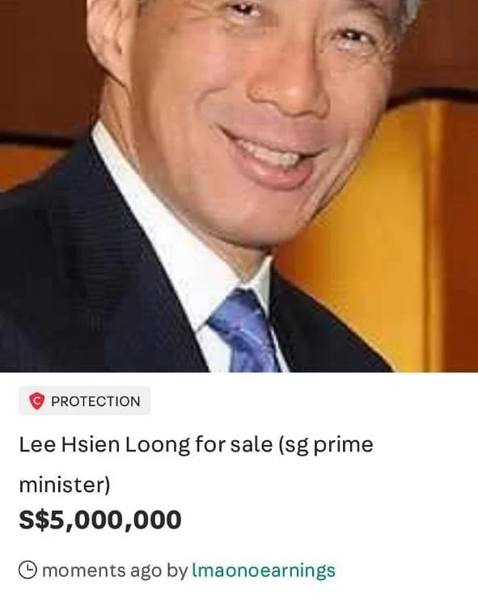
Fraudulent
Savings $350,000
ROI 2X
Lenson
How it works:
Assigns risk score
Ban sellers who exceed specified risk score
Effective in detecting fraudulent listings and sellers
Carousell
Notes:
One of the solutions that Carousell uses to prevent fraud is Sift. Sift is an automation and machine learning technology that detects fraudulent listings and sellers. It assigns a risk score to sellers based on their behavior, and this helps Carousell to remove fraudulent listings.
Sift has been effective in detecting fraudulent listings and sellers. According to Tan, S.L (n.d.), Sift detected 10% more fraudulent listings and 23% more fraudulent sellers in 2019. It has also saved Carousell more than $350,000 per year while achieving a return on investment (ROI) of 2 times.

Slide 10
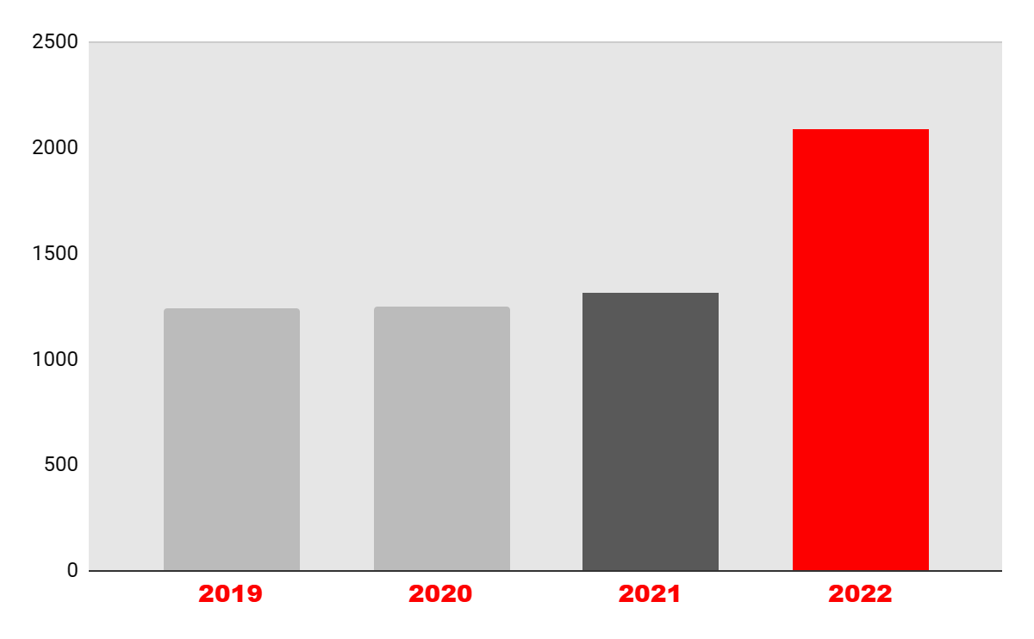
Limitations of Sift
Lenson
Number of cases
Phishing by-passes Sift checks
Sift was trained to identify suspicious seller behavior via their listings
Gaps in Risk Checks for Buyers
Sift targets solely on the behaviour of sellers. This creates a gap for bad actors to thrive as buyers
Carousell
Notes:
While sift is able to detect fraudulent listings and sellers, these measures do not extend to phishing scams.
Unfortunately, Carousell's current fraud detection system, called Sift, is not equipped to detect these types of scams. This is because Sift was trained to identify suspicious seller behavior via their listings, and phishing scams operate outside of this system.
This creates a significant gap for bad actors to thrive and leaves both buyers and sellers vulnerable to these types of scams. In fact, the number and severity of e-commerce scams on Carousell's platform have been increasing since 2019, which is a clear indication that Sift is lacking in detecting shifts in e-commerce scams.
Therefore, Carousell must take action to address this issue and implement measures to protect its users from phishing scams. This may involve investing in new fraud detection technology that can detect and prevent phishing scams, as well as educating users about the risks of phishing and how to avoid falling victim to these types of scams.
In conclusion, it is essential for Carousell to address the issue of phishing scams on its platform. By implementing new measures to detect and prevent these types of scams, Carousell can help protect its users and maintain the trust of its community. Thank you for listening.

Slide 11

Carousell Protection
Lenson
4.5% of Selling Price as Fee
Sellers
Buyers
Escrow Agent
Carousell

Slide 12
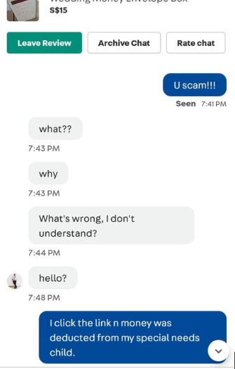
Limitations of Carousell Protection
Lenson
High Fees
The 4.5% transaction fee is too expensive for users
Creates opportunity for Phishing
Scammers exploit the situation by pretending to be facilitating payment for users avoiding Carousell Protection fees
Inflexible Fees
Transaction fees are used to maintain costs of Carousell Protection and third party fees from Stripe
Carousell
Notes:
While sift is able to detect fraudulent listings and sellers, these measures do not extend to phishing scams.
Unfortunately, Carousell's current fraud detection system, called Sift, is not equipped to detect these types of scams. This is because Sift was trained to identify suspicious seller behavior via their listings, and phishing scams operate outside of this system.
This creates a significant gap for bad actors to thrive and leaves both buyers and sellers vulnerable to these types of scams. In fact, the number and severity of e-commerce scams on Carousell's platform have been increasing since 2019, which is a clear indication that Sift is lacking in detecting shifts in e-commerce scams.
Therefore, Carousell must take action to address this issue and implement measures to protect its users from phishing scams. This may involve investing in new fraud detection technology that can detect and prevent phishing scams, as well as educating users about the risks of phishing and how to avoid falling victim to these types of scams.
In conclusion, it is essential for Carousell to address the issue of phishing scams on its platform. By implementing new measures to detect and prevent these types of scams, Carousell can help protect its users and maintain the trust of its community. Thank you for listening.

Slide 13
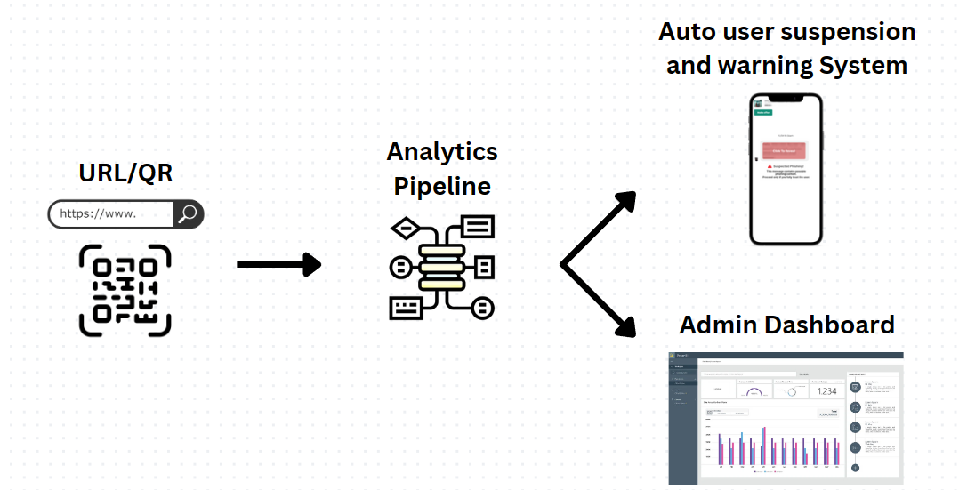
02
Proposed Solution
Lenson
Carousell

Slide 14
Overview
Lenson
Automatically warn and suspend bad actors
Screens a given URL and flag any potentially malicious ones
Presents predicted information in a concise and actionable format
Carousell

Slide 15

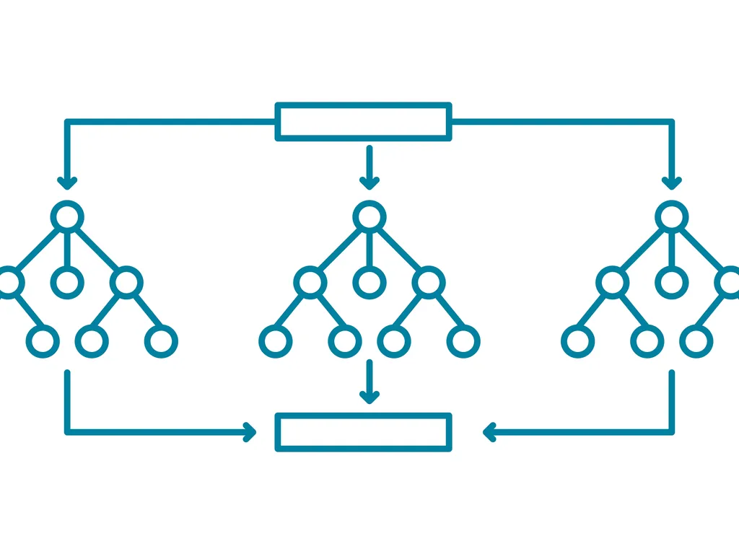
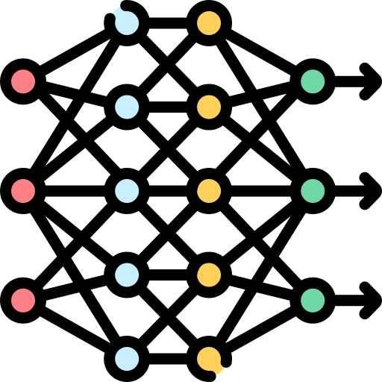


Analytics Pipeline (Overview)
Lenson
Data Engineering 1 | Layer 1 | Data Engineering 2 | Layer 2
Benign (output)
QR Code
Benign or
Malicious
Converted
Malicious Links
Features
Features
URL
Trained to be sensitive to malicious links
Follow link and extract content from website
Carousell

Slide 16
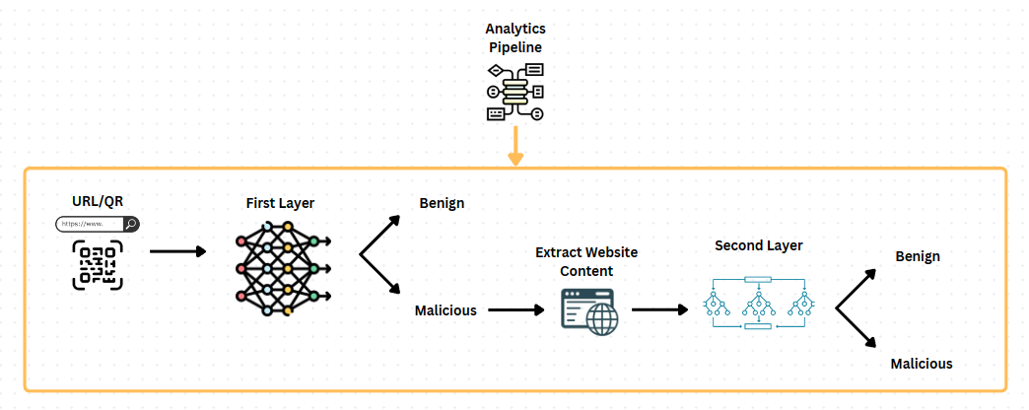
Analytics Pipeline (Overview)
Lenson
Low Overhead
High Confidence
Low Error
Scraping website incur high overhead
Our two layer approach was specially designed prevent the need to scrape all links
Reduces Lag time for users
First layer tuned to be highly sensitive to malicious links
Most malicious links will be captured by the first layer
The second layer supports the first layer
Prevent legitimate links from being flagged as malicious
Carousell

Slide 17
Overview
Lenson
Automatically warn and suspend bad actors
Screens a given URL and flag any potentially malicious ones
Presents predicted information in a concise and actionable format
Carousell
Notes:
With a deeper understanding of how analytics pipeline works and the strong capabilities of predicting if a given URL or QR code is malicious or not, we will now showcase how we develop our analytics pipeline and following that, we will explain how Carousell can utilise the predicted information to solve their problems

Slide 18
Models Required
Syed
URL detection model
Website content detection model
First layer - to detect potentially malicious URLs
11 input variables
Second layer - to detect potentially malicious websites
19 input variables
1 target variable
Carousell

Slide 19
03
Dataset & Model Development
Syed
Carousell

Slide 20
Data Cleaning and Balancing
Syed
Phishing Website Dataset from kaggle
Contained 11055 samples with 32 columns (1 index, 1 result, 30 features)
Contained no empty or invalid data
11 columns used for phishing URL detection
19 columns used for phishing website content detection
Imbalanced data - 4898 phishing records, 6157 legitimate records
Carousell

Slide 21
Data Cleaning and Balancing
Syed
Downsampling vs Upsampling
Downsampling preferred to avoid introducing duplicate records that may lead to overfitting
Due to large sample size, not too much information lost from downsampling
Cleaned and balanced data split into 2 sets - 1 for each model
Carousell

Slide 22
Model Development
Tai Jia An
70:30 train-test split ratio: 70% of dataset to train, 30% to test models
False Negative: The number of phishing cases classified as legitimate by the model
False Positive: The number of legitimate cases classified as phishing by the model.
False Positive Rate = False Positive / (True Negative + False Positive)
False Negative Rate = False Negative / (True Positive + False Negative)
Precision = True Positive / (True Positive + False Positive): proportion of true positive results among total number of positive predictions
Recall = True Positive / (True Positive + False Negative): proportion of true positive results among total number of actual positive cases
Carousell
Notes:
For each of the 2-layer models, we conducted a train-test split of the respective datasets in the ratio 70:30. The Accuracy, False Positive Rate (FPR), False Negative Rate (FNR), Precision, and Recall of balanced test datasets were recorded and compared.
False Negative: The number of phishing cases classified as legitimate by the model
False Positive: The number of legitimate cases classified as phishing by the model.
False Positive Rate = False Positive / (True Negative + False Positive)
False Negative Rate = False Negative / (True Positive + False Negative)
Precision = True Positive / (True Positive + False Positive),
measuring the proportion of true positive results among the total number of positive predictions made by a model.
Recall = True Positive / (True Positive + False Negative),
measuring the proportion of true positive results among the total number of actual positive cases in the dataset.

Slide 23

Model Development
Tai Jia An
Malicious URL Models' Performance
Model | Accuracy | False Positive Rate | False Negative Rate | Precision | Recall
MARS | 0.8875 | 0.08259 | 0.1159 | 0.8920 | 0.8489
Random Forest | 0.9011 | 0.06659 | 0.1396 | 0.9113 | 0.8604
Neural Network | 0.9017 | 0.07456 | 0.09895 | 0.9010 | 0.8741
Highest Accuracy + Lowest False Negative Rate
Neural Network → Optimal Model
Carousell
Notes:
For each of the 2-layer models, we conducted a train-test split of the respective datasets in the ratio 70:30. The Accuracy, False Positive Rate (FPR), False Negative Rate (FNR), Precision, and Recall of balanced test datasets were recorded and compared.
Based on the comparison metrics table (Table 2), it shows that Neural Network has a higher accuracy (90.17%) and recall (87.41%) among the other 2 models. Even though the Neural Network model has a slightly higher false positive rate (7.47%) and lower precision (90.10%) than Random Forest model, having a lower false negative rate (9.90%) and higher accuracy is the main priority when detecting malicious URLs. With that said, the Neural Network model produces better performance in all other metrics as compared to the other 2 models. Therefore, Neural Network would be the optimal model selection for the detection of malicious URLs.

Slide 24
Model Development
Tai Jia An
Tuning Neural Network Model: Threshold, the minimum value required to classify an outcome as phishing / legitimate, is adjusted to find the lowest false negative rate.
Malicious URL Neural Network Model's Performance (Optimal Threshold)
Model | Accuracy | False Positive Rate | False Negative Rate | Precision | Recall
Neural Network | 0.8450 | 0.01708 | 0.03775 | 0.9622 | 0.6767
False Negative Rate
9.9 % → 3.8 %
Carousell
Notes:
As mentioned in our proposed solution, the false negative rate (FNR) must be minimised. To reduce the FNR, we adjusted the threshold for the Neural Network model which changes the minimum value required to classify an output as phishing or legitimate. We found an optimal threshold value by testing different threshold values for the Neural Network model and found that the threshold value of 0.1 gives one of the lowest FNR while having the highest accuracy for this cutoff value (Appendix F). Thus, a threshold of 0.1 will be used to build the final Neural Network model and the following shows the resulting metrics of our final model,

Slide 25
Model Development
Tai Jia An
Malicious Website Content Models' Performance
Model | Accuracy | False Positive Rate | False Negative Rate | Precision | Recall
MARS | 0.8706 | 0.04129 | 0.2393 | 0.9355 | 0.7604
Random Forest | 0.9180 | 0.05739 | 0.1130 | 0.9248 | 0.8870
Neural Network | 0.9041 | 0.08545 | 0.1077 | 0.8923 | 0.8911
Highest Accuracy + Relatively High Precision & Recall
Random Forest → Optimal Model
Not further tuned to reduce false negative rate as the second layer overall accuracy is the most important, determining actions to be taken
Carousell
Notes:
Upon comparison (Table 4), Random Forest was selected as the best model choice for detecting malicious websites. Random Forest has the highest overall accuracy (91.80%) among the 3 models while still having a relatively high precision (92.48%) and recall (88.70%). In comparison with the MARS model, it has a much lower false negative rate (11.30%), which is crucial when it comes to detecting malicious websites. Even though Neural Network models have a slightly lower FNR (10.77%), it is noteworthy that Random Forest outperforms Neural Network models in other metrics, such as lower FPR (5.74%), thus Random Forest model is being claimed as the best model for malicious website detection.
The model was not further tuned to reduce its FNR as for the second layer, the overall accuracy is deemed to be the most important factor, as this final layer is the main determinant of what action should be taken. Therefore, it cannot be too sensitive towards false negatives, as it would lead to too many unfair suspensions nor can it be too sensitive towards false positives, as it would let too many malicious URLs pass through without warnings.

Slide 26
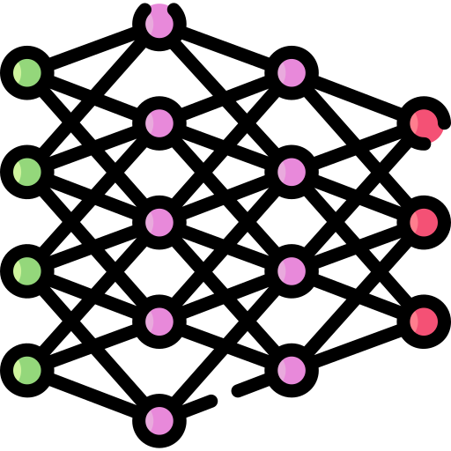
Evaluation of Models
Tai Jia An
Combination of both Neural Network and Random Forest models are viable in predicting whether a URL is malicious
Neural Network Model in the First Layer
Low false negative rate of only 3.8% with a decreased cut-off threshold
Random Forest Model in the Second Layer
High accuracy of 91.8% & low false negative rate of only 5.7%
Carousell
Notes:
From the above results, we see that both chosen models are viable in achieving their respective goals. The decreased cut-off for the Neural Network classifier to classify a URL as malicious ensures that there is a low probability of false negatives with a FNR of only 3.8%. The added checks by the second layer further ensures that there are few false positives overall as the second model is highly accurate and has a FPR of only 5.7%. The two models combined would ensure that the vast majority of truly malicious URLs are blocked and all users have a smooth experience with minimal disruptions.

Slide 27

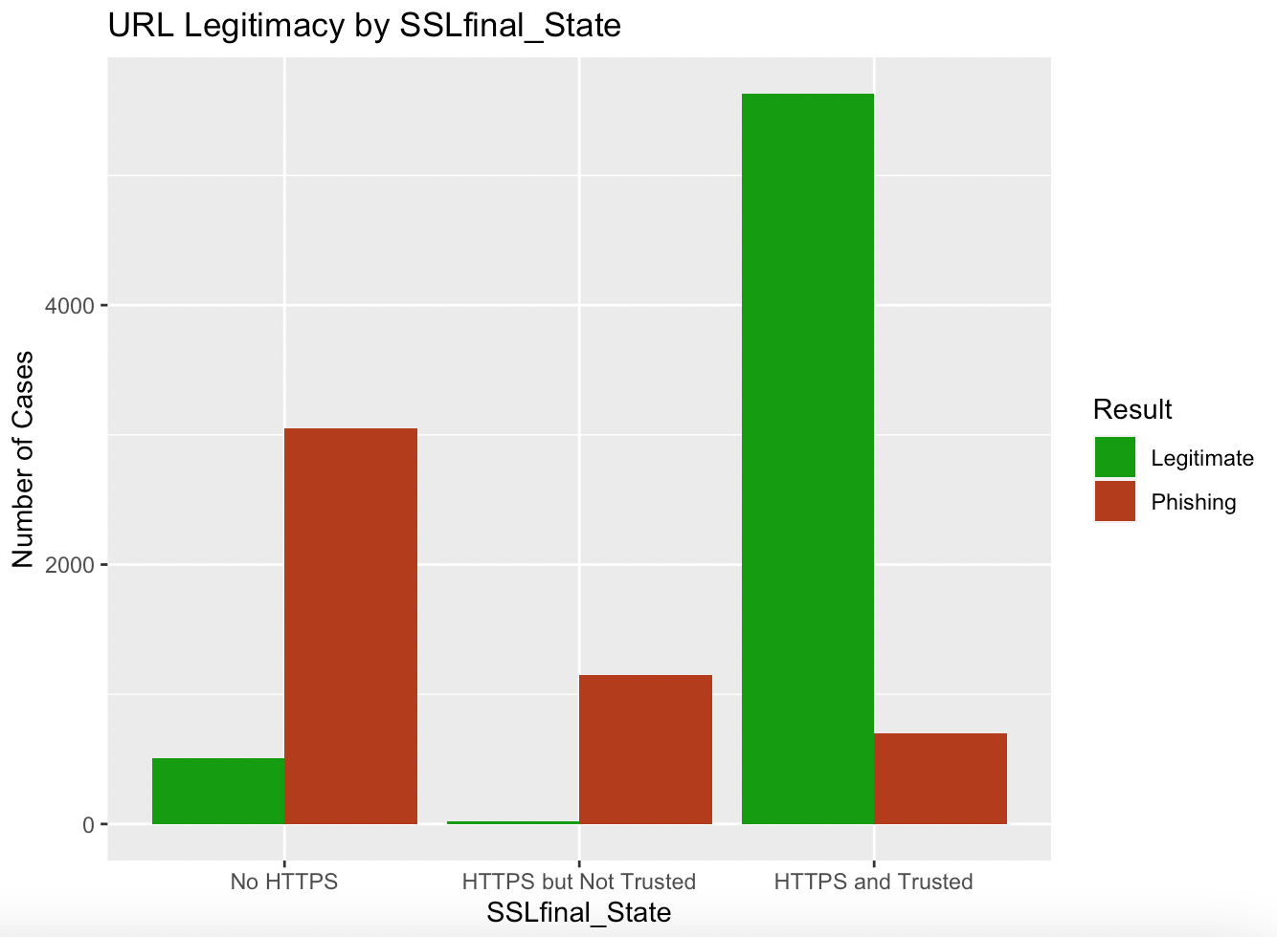
Key Insights
Tai Jia An
SSLfinal_State has the most significant relationship with URL malignancy
Whether the website is secured and comes with trusted certificates
Carousell
Notes:
From the EDA of the URL data, we see that of all the features, SSLfinal_state has the most significant relationship with whether a URL is malicious. SSLfinal_state is a technical feature that indicates whether the website is secured and has the trusted certificates used by legitimate websites. This is an important finding and presents an added opportunity for Carousell to quickly eliminate a large number of malicious websites from being shared among users by simply preventing any website that does not meet this requirement from being sent. This is a quick and easy way for Carousell to reduce the total number of checks they have to conduct and the overhead involved in the process. This also ensures that innocent users that may have unknowingly shared a malicious URL due to their ignorance are notified early and are reminded to check the authenticity of websites they share.

Slide 28

04
Recommendation & Dashboard

Slide 29


Proposed Solution
Phoebe
Auto User Suspension and Warning
Admin Dashboard
Carousell

Slide 30
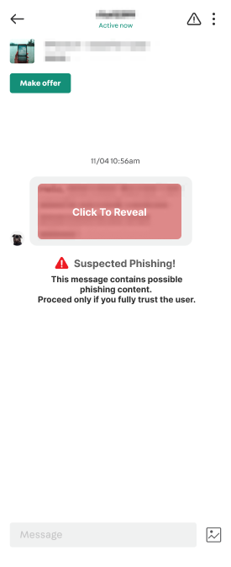
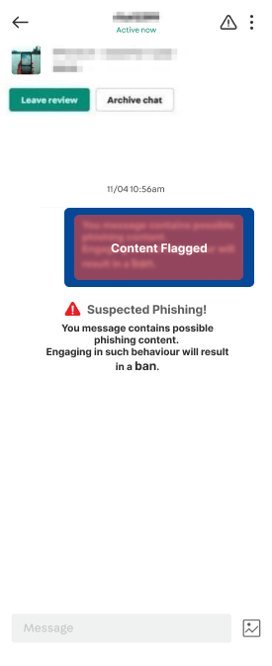
Auto User Suspension and Warning
Phoebe
Receiver’s Warning
Sender’s Warning
Integrate our model into Carousell’s existing system with minimal changes
URL link is flagged as malicious
Message is hidden
Warning message is displayed
Users can still choose to bypass warning and access the message
Carousell

Slide 31
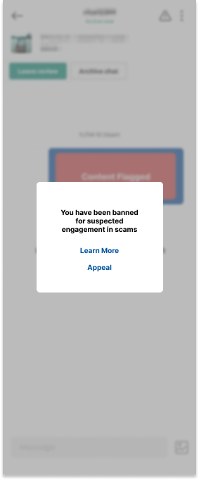
Auto User Suspension and Warning
Phoebe
Sender’s Suspension Notification
Sender’s Warning
The number of times the sender’s messages has been flagged will be tracked.
If warnings are triggered more than 3 times, account will be suspended
User’s posts will be hidden
User has the option to appeal if an error had been made
Carousell

Slide 32
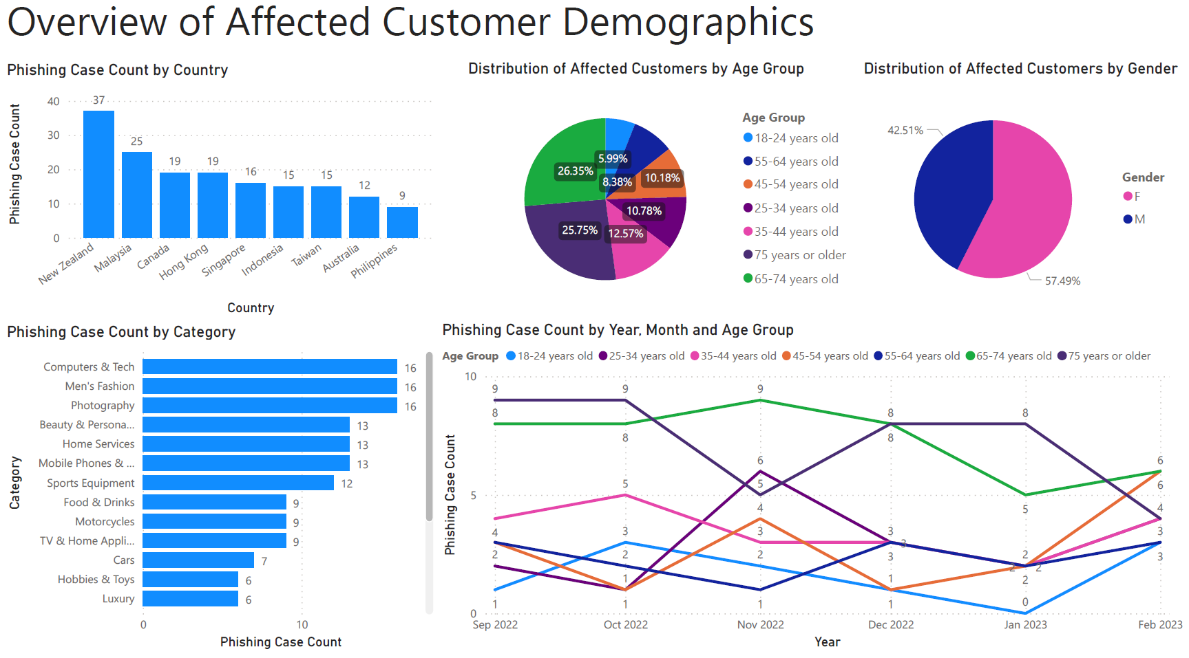
Admin Dashboard
Phoebe
Overview of phishing cases
Detailed information on demographics of affected users
Overview of suspended users
Carousell

Slide 33
Admin Dashboard
Phoebe
Overview of Phishing Cases
Demographics of Affected Users
Overview of Suspended Users
Shows the overall trend on phishing scams over different periods.
Helps in analysing the effects of any measure to reduce phishing on their platform
Provide insights on scammers’ targeted groups
Allows staff to craft targeted solutions and improve current solutions
Provide insights about flagged users.
Allows staff to create solutions that prevents scammers from abusing the platform while maintaining a convenient user experience for others
Carousell

Slide 34
Benefits of Proposed Solution
Phoebe
Auto Suspension and Warning System:
Additional layer to protect users from potential scams
Easily deployed at scale without much need for Carousell to greatly increase workforce.
Dashboard provides real-time information for management
To monitor real-time activities on Carousell
To take rapid action based on scam trends
Carousell

Slide 35

Feasibility
Tai Jia An
Models' performance prove the feasibility of our proposed solutions
Auto user suspension & warning system can receive models' output and take appropriate actions swiftly
All parties would be aware of potential phishing attempts
Quick and decisive suspension of scammers' accounts to prevent damage
Cloud providers can support machine learning & analytical solutions
Carousell
Notes:
The performance of our models prove the feasibility of the proposed solutions, as the auto user suspension and warning system would be able to receive the output from the models and take the appropriate actions. The automated system’s response would be rapid and ensure that all parties receive the correct warnings and are aware of potential attempts at phishing. Scammers would also very quickly have their accounts suspended and be prevented from causing any further harm.
Deploying machine learning and analytical solutions have never been easier with the emergence of cloud providers.

Slide 36


Feasibility
Tai Jia An
Initial upfront investment required but models can be scaled up easily
Carousell's pledge to allocate more budget towards reducing phishing & abundance of in-house data allow effective implementation of solution
Existing customer service & content moderation teams can support operations with minimal disruption due to solution's automation & easy-to-use, efficient dashboard
Experienced software team at Carousell can easily connect analytical models & auto suspension system with the platform
Carousell
Notes:
This will require an upfront investment from Carousell in order to purchase the cloud infrastructure needed to run the models at the required scale. However, after this initial investment, the models can be scaled up easily as multiple instances can be deployed concurrently ensuring that there is sufficient bandwidth for Carousell to screen all of the URLs and QR codes sent by users.
Carousell already has existing customer service and content moderation teams that would be able to pick up the new tasks required such as managing user appeals. Although some new staff may need to be hired to keep up with the increased overhead, this should be minimal due to the automated nature of the solution and the efficiency gains
from the dashboard.
The software will also need to be updated to enable the auto suspension system and connect with the analytics models, however, this is not an issue given Carousell’s experienced software team.
Carousell has also already pledged to allocate more of its budget towards reducing phishing on its platform, ensuring that there is sufficient funding for such expansions to
occur (Lim, 2022). The additional funds along with the abundance of data that Carousell already has plus what it will be able to collect over time will allow it to implement this solution effectively.

Slide 37

Limitations
Tai Jia An
Trade-off between Neural Network model's accuracy and false negative rate
Carousell's in-house data can be used to further train & tune the model to achieve higher accuracy & lower false negative rate concurrently
Only two layers of checks: some phishing URLs may still pass through & greater computational power is required to train with more models per layer
Supplement with people-centric solution to increase users' scam detecting capabilities
Possible privacy concern: abide by Personal Data Protection Act to mitigate
Carousell
Notes:
One of the limitations of this solution is that there is a trade-off in the accuracy of our Neural Network model and its false negative rate, and we chose to reduce the false negative rate in favour of increasing the accuracy. Ideally, we would be able to achieve a high accuracy with the lowest possible false negative rate. As our solution was developed using publicly available data on phishing websites, it may be imperfect; If Carousell were to collect its own data and further train and tune the model, this limitation could be mitigated and the models could achieve a higher accuracy as well as a low false negative rate.
Another limitation is that with only 2 layers of checks, it is still possible that some number of malicious URLs may pass through both layers and be sent to unsuspecting users. One way to ensure the highest safety would be to use more models per layer, however, this method is expensive as it requires more computational power to train the models, as well as to deploy them. It will also increase the lag time for users that send URLs or QR codes, as it would have to pass through more checks before it gets sent. Carousell can also supplement our technical solution with a people-centric solution aimed at increasing their users’ scam detecting capabilities, to ensure that they are kept safe even from those few malicious links that do pass through.
A possible issue Carousell may encounter is that implementing this solution requires analysis of user’s chats to be able to detect links and QR codes. This may pose a privacy concern for users and many may be uncomfortable with this, however, if Carousell is transparent of its processes and strictly abides by the Personal Data Protection Act (PDPA), users would have little reason to be concerned.

Slide 38



Solutions to Further Reduce Carousell Phishing Rates
Tay Wei Ming
1
2
3
Blacklisting
Partnership
Communication
Malicious URLs that have been detected, will be blacklisted
Collaborate with other platform to improve the ecommerce industry in phishing activities
Better outreach of anti-phishing effort to its stakeholders.
Carousell

Slide 39
URL Blacklisting to Reduce Carousell Phishing Activities
Tay Wei Ming
Recommendation
How the solution works
Benefits
URLs Blacklisting
Faster detection of malicious URL
Rejects Links that do not meet proper SSL final state requirement.
Malicious URLs or past URLs phishing cases will be blacklisted.
User attempting to access those URLs will be alerted.
Increases cost efficiency of the system
Reduce overheads & overloading the model
Carousell

Slide 40
Partnership with Others Reduces Carousell Phishing activities
Tay Wei Ming
Recommendation
How the solution works
Benefits
Partnership with other ecommerce platform
Share phishing or any suspicious trend of malicious cases.
Exchange knowledges on better malicious detection methods
Limit the occurrence of same phishing activities on other platform.
More accurate and reliable model
Requires lesser effort in researching the best optimal detection method
Safer environment for all users
Carousell

Slide 41
Improve public relations
Tay Wei Ming
Recommendation
How the solution works
Benefits
Promote anti-phishing effort to improve public and investor relations
Show the phishing efforts that Carousell have been doing E.g. constantly updates user of phishing trends
Present Carousell phishing performance report to investors
Multi-channel communication to further promote Carousell’s anti-phishing efforts
Improve brand image and reputation
Carousell could achieve its goals towards a successful exit strategy
Boost users and investors confidence, better ROI for investors
Carousell

Slide 42

05
Conclusion
Tay Wei Ming

Slide 43


Conclusion
01
Identify some of the business problem that Carousell is facing
02
Analytical solution (including dashboard) to tackle the problem
03
Non-analytical solution for Carousell to further reduce phishing activities
04
How both Carousell and stakeholders benefits from our recommendation

Slide 44


Thank you
Hope you could consider our proposed recommendation.

Slide 45

06
Appendix

Slide 46
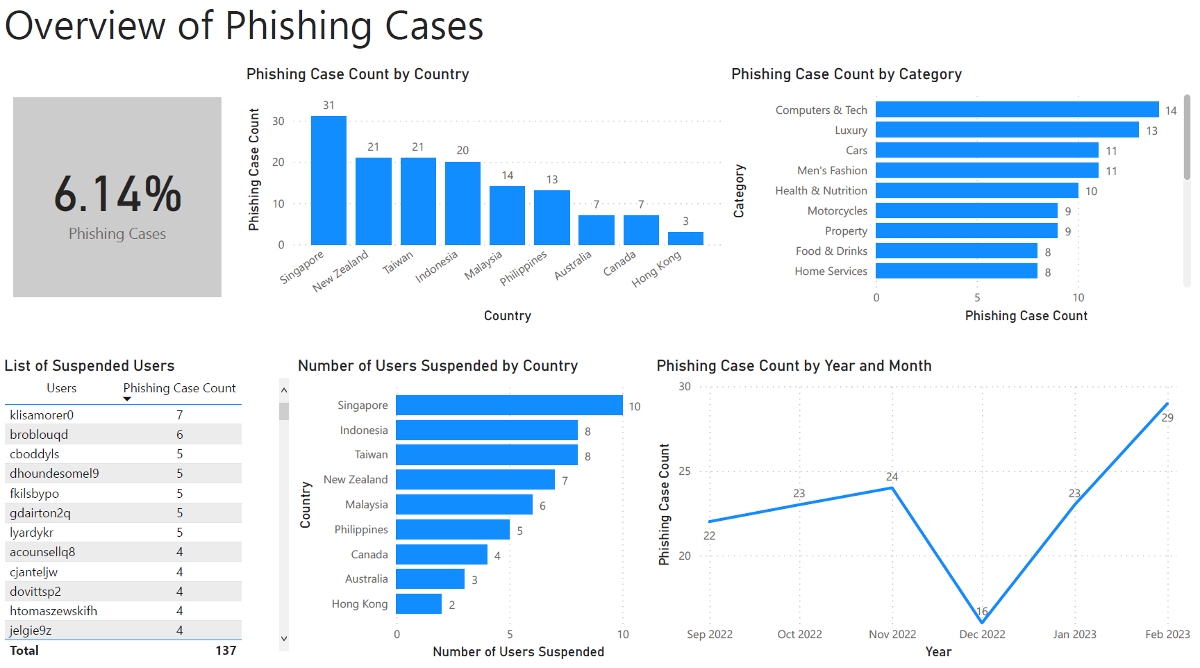

Slide 47
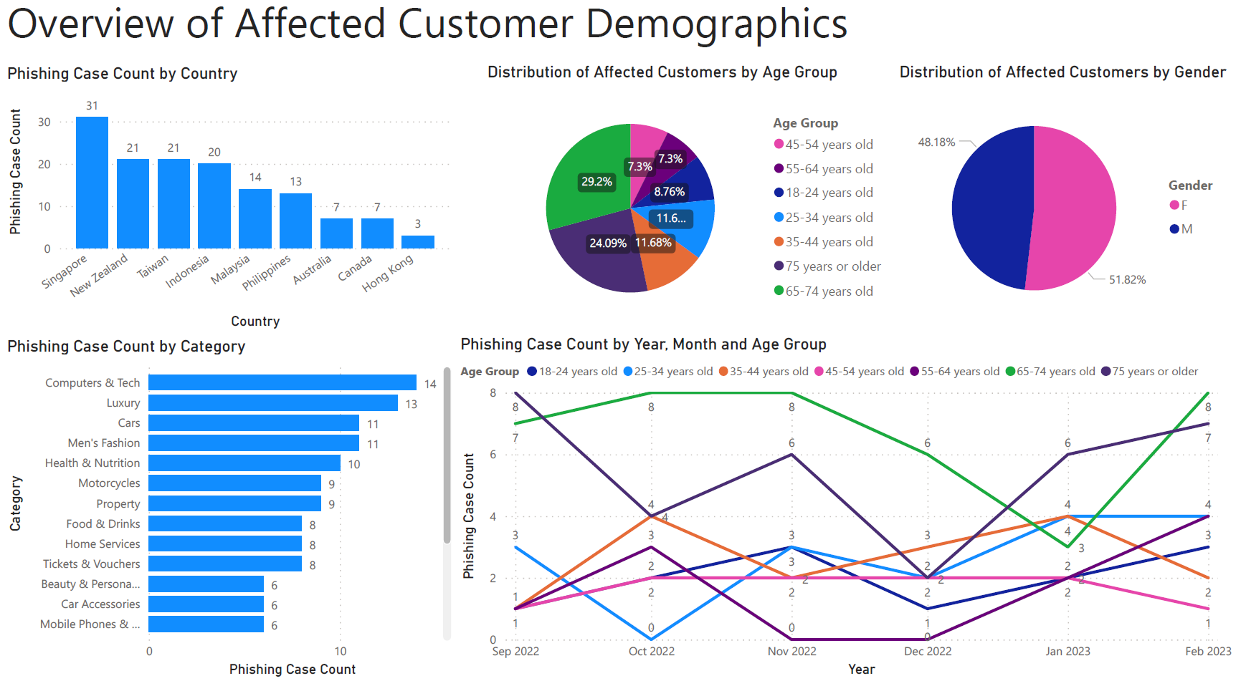

Slide 48
